Slide 1
Whole School Pop-up
Christmas Card Project
Aspect of DT – Mechanisms / Paper Engineering
Product - A Christmas card with 3D/moving parts
User - To give to family
Purpose - To celebrate Christmas

Slide 2
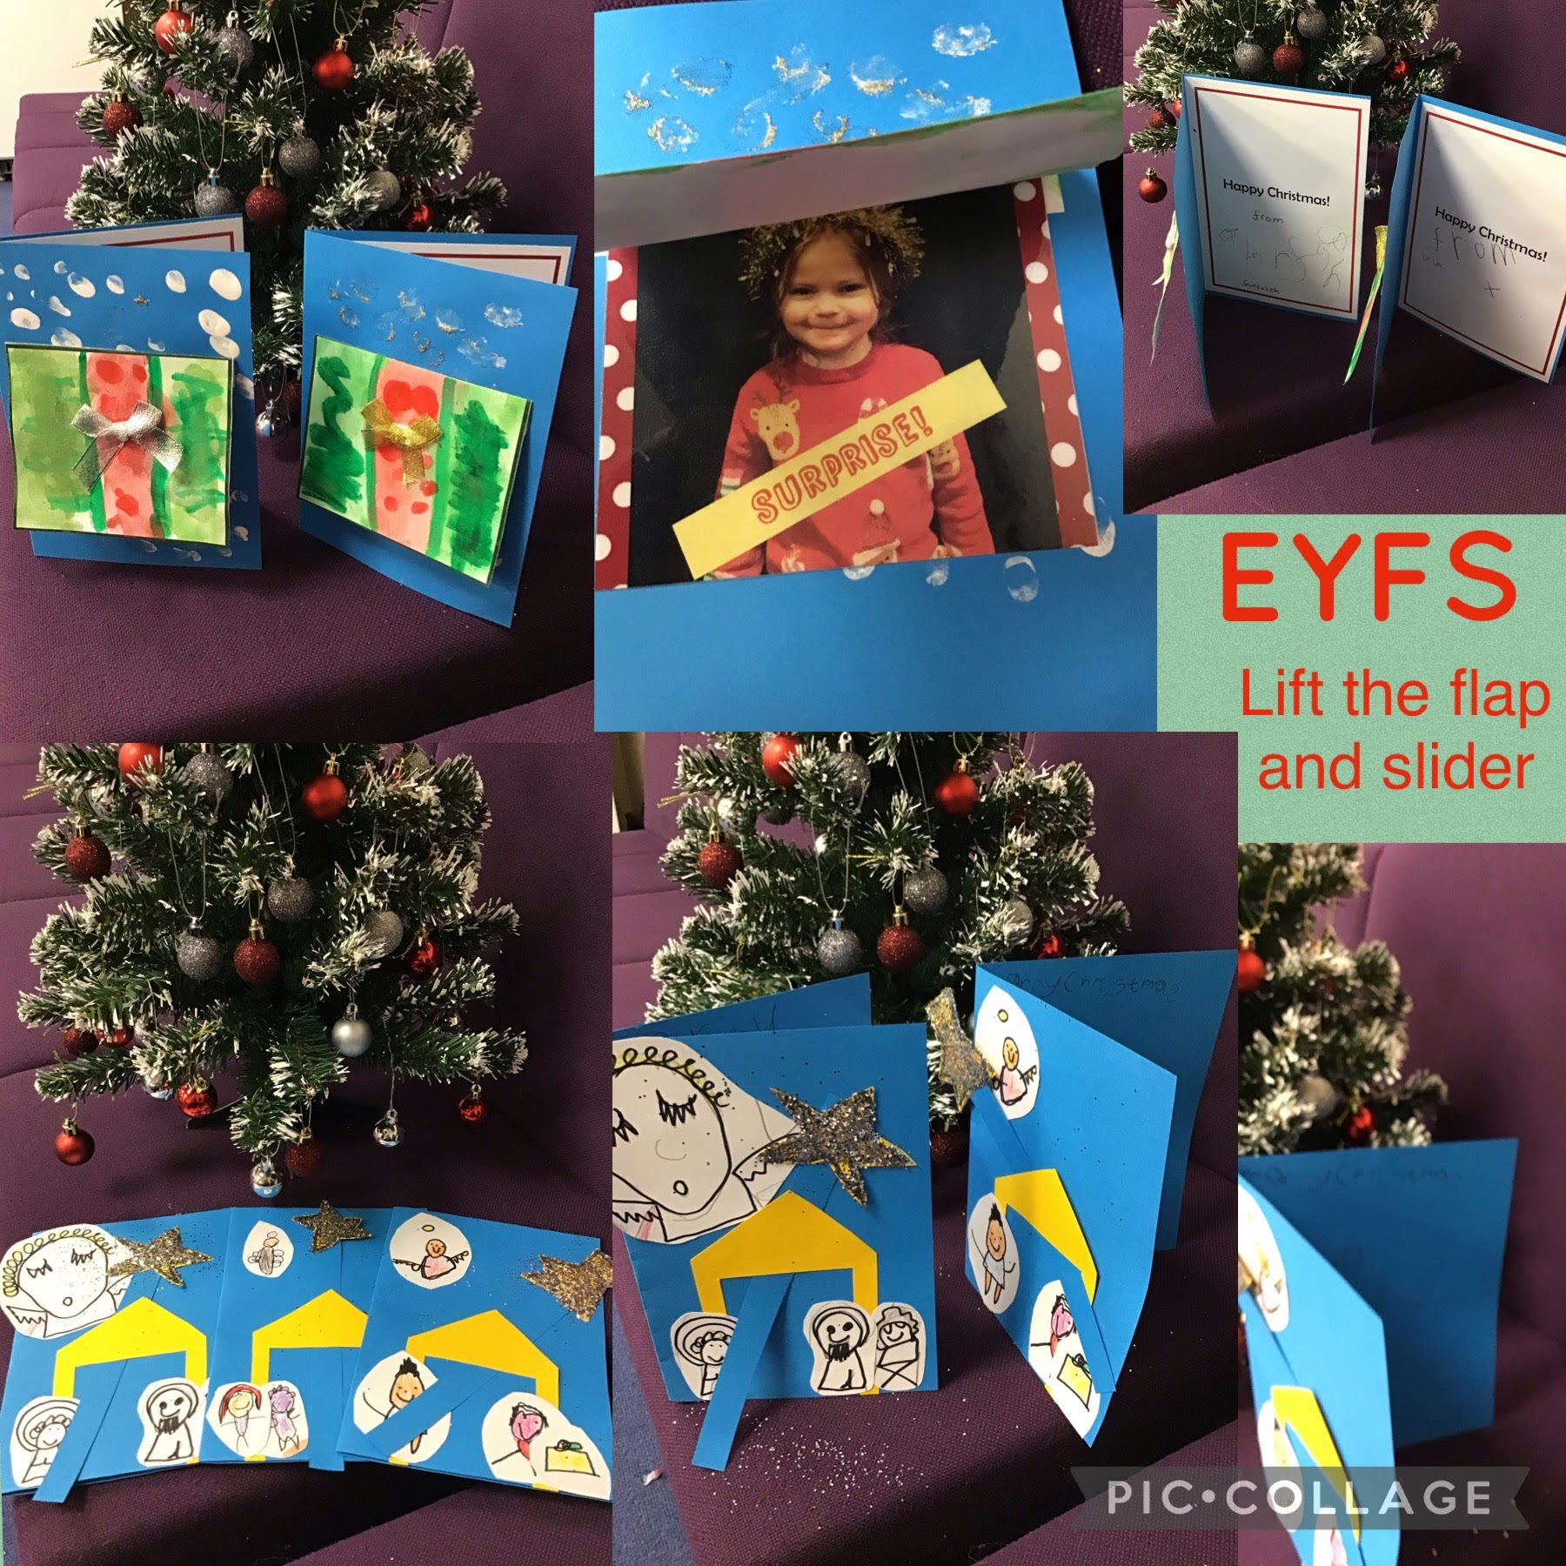

Slide 3
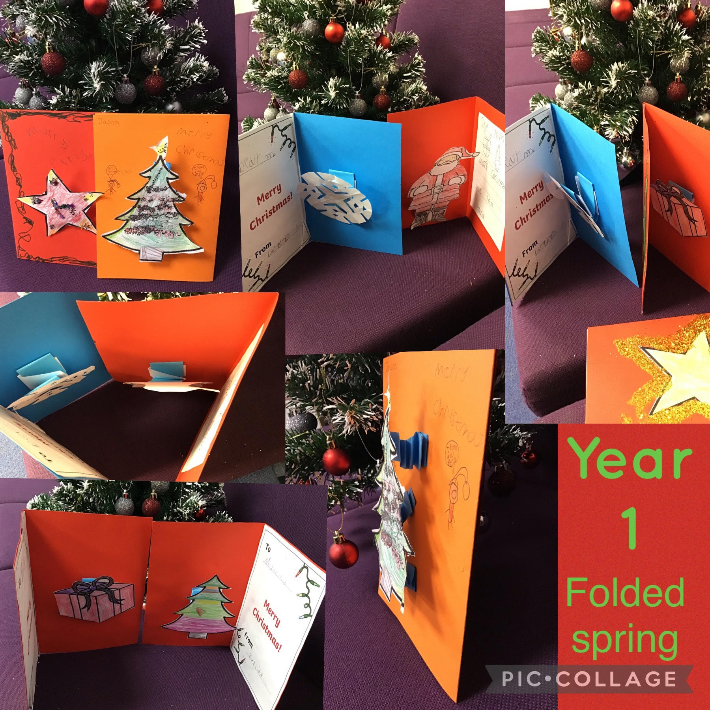

Slide 4
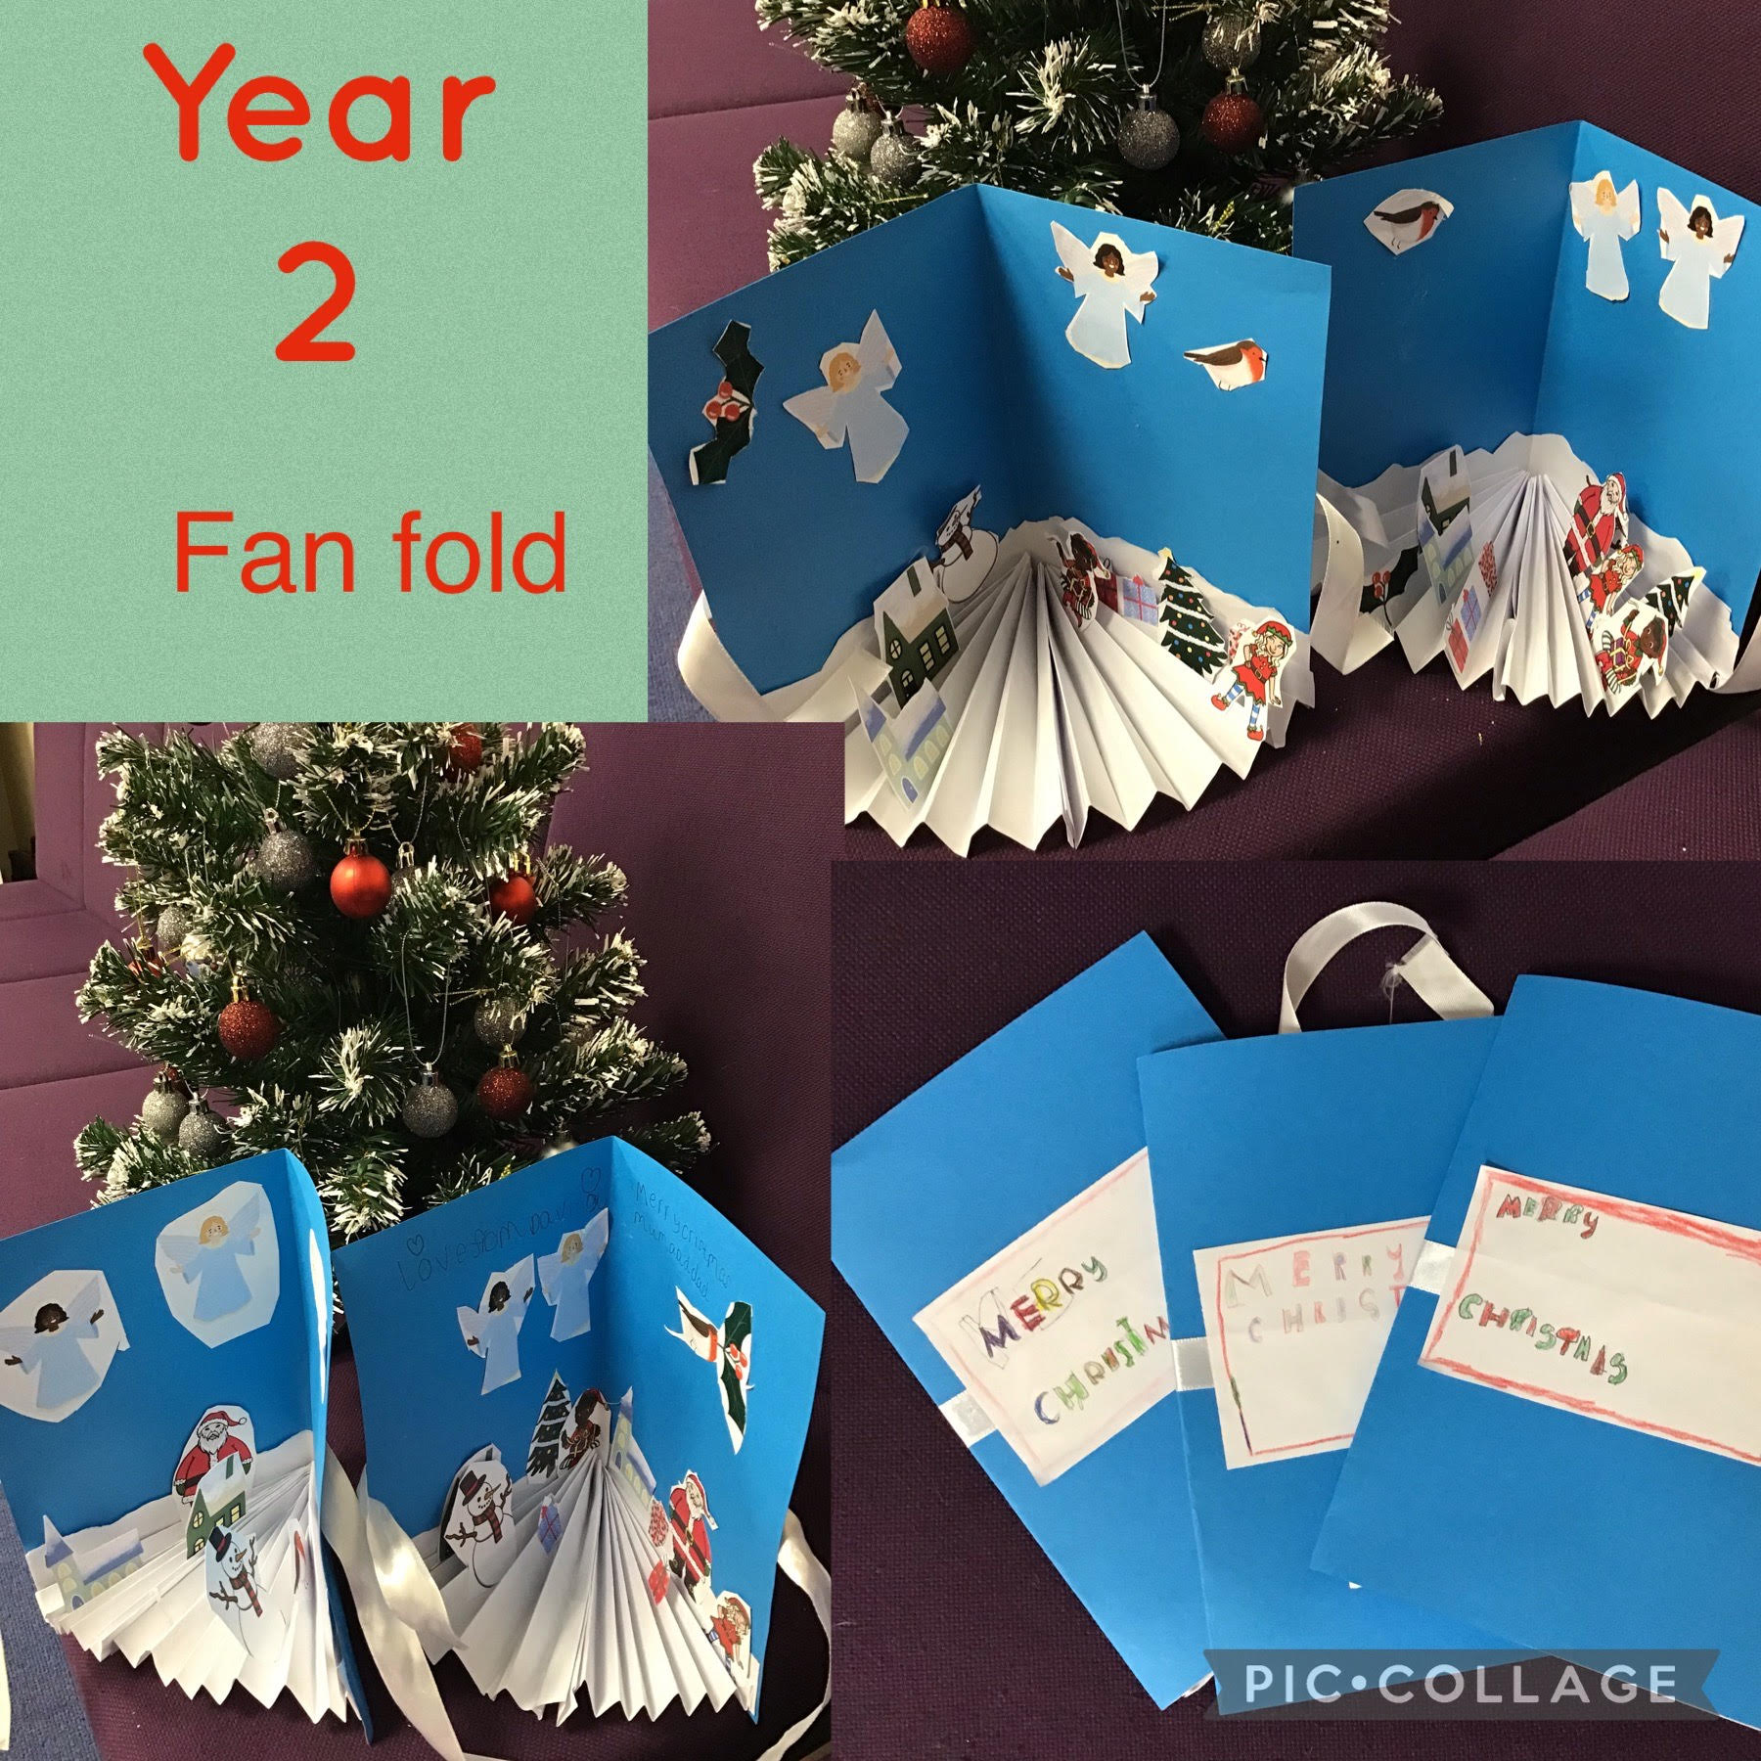

Slide 5
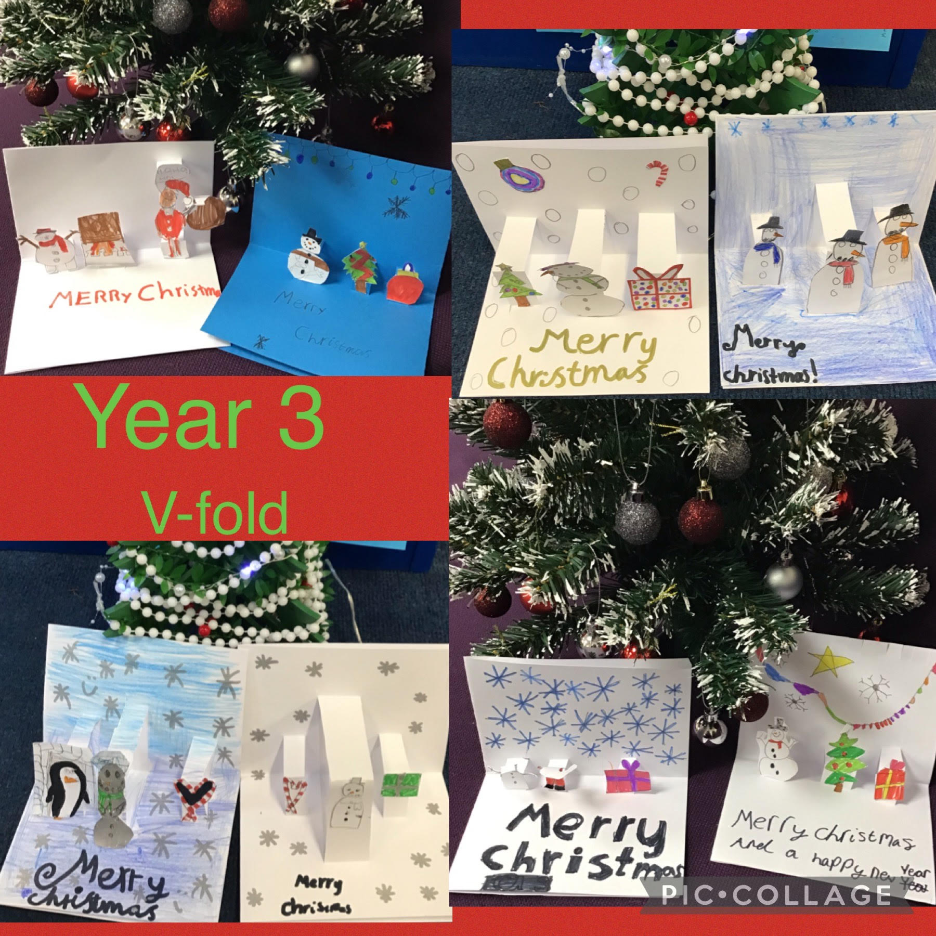

Slide 6
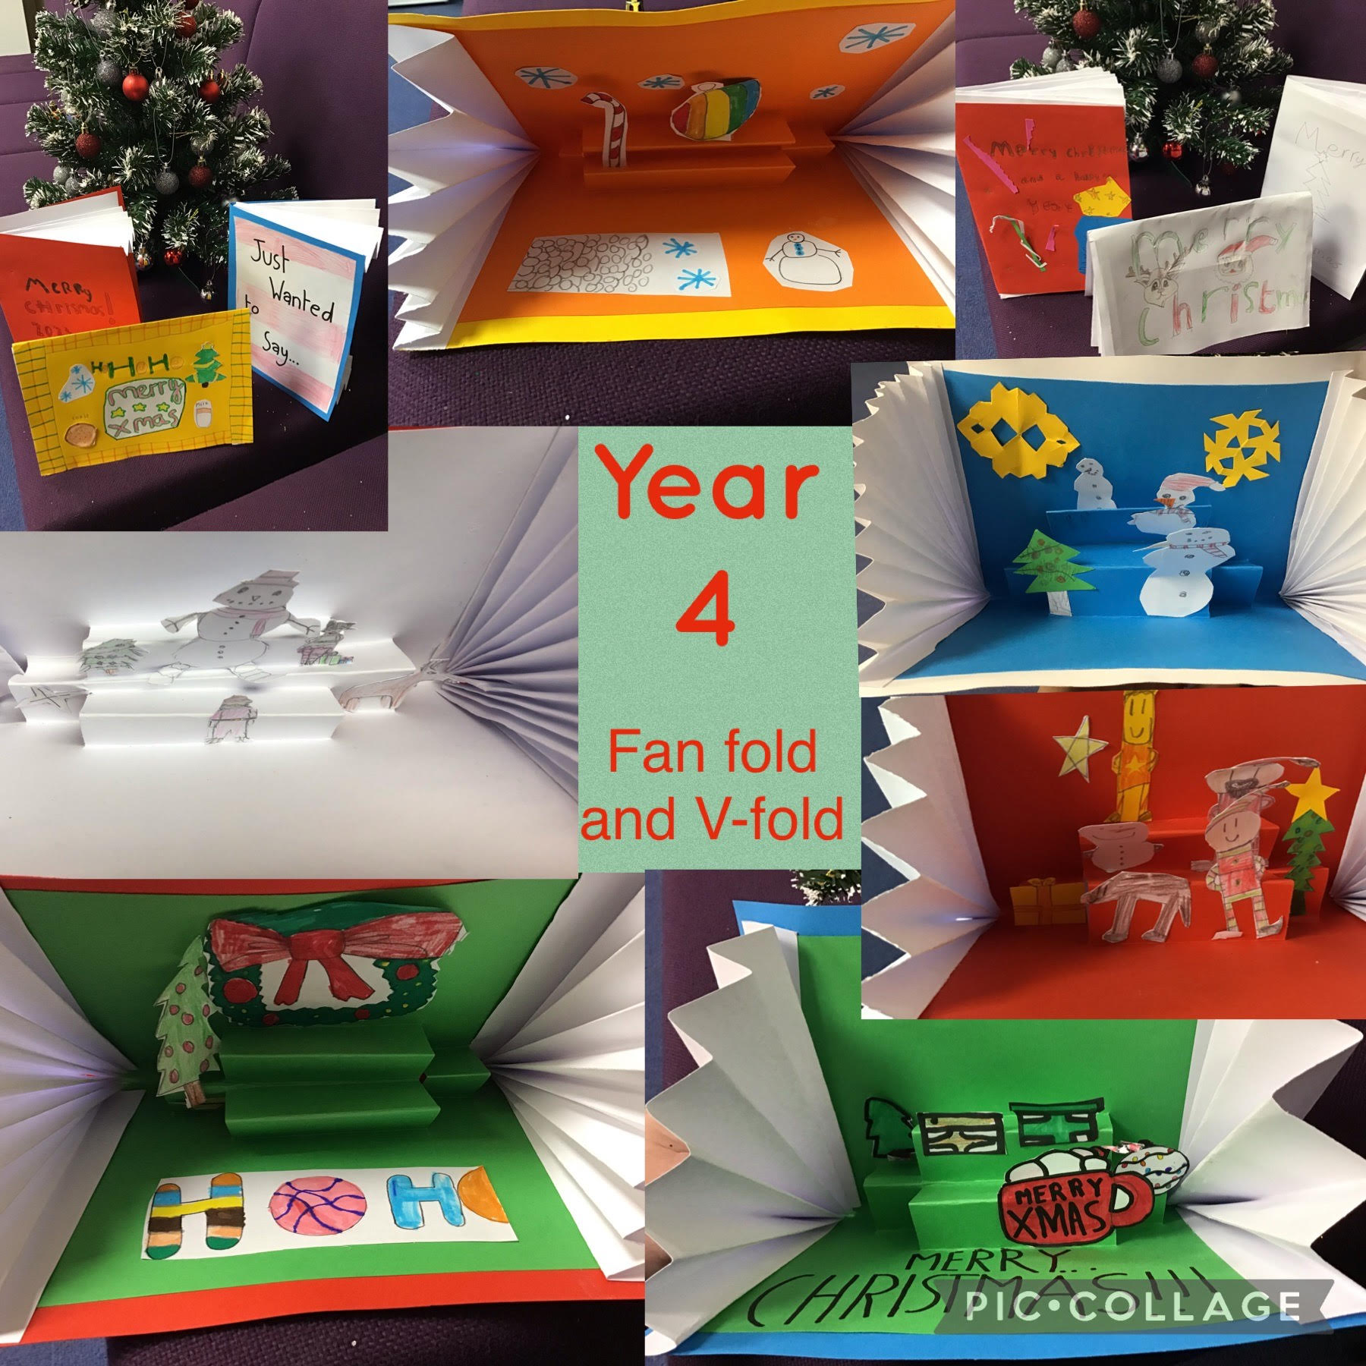

Slide 7
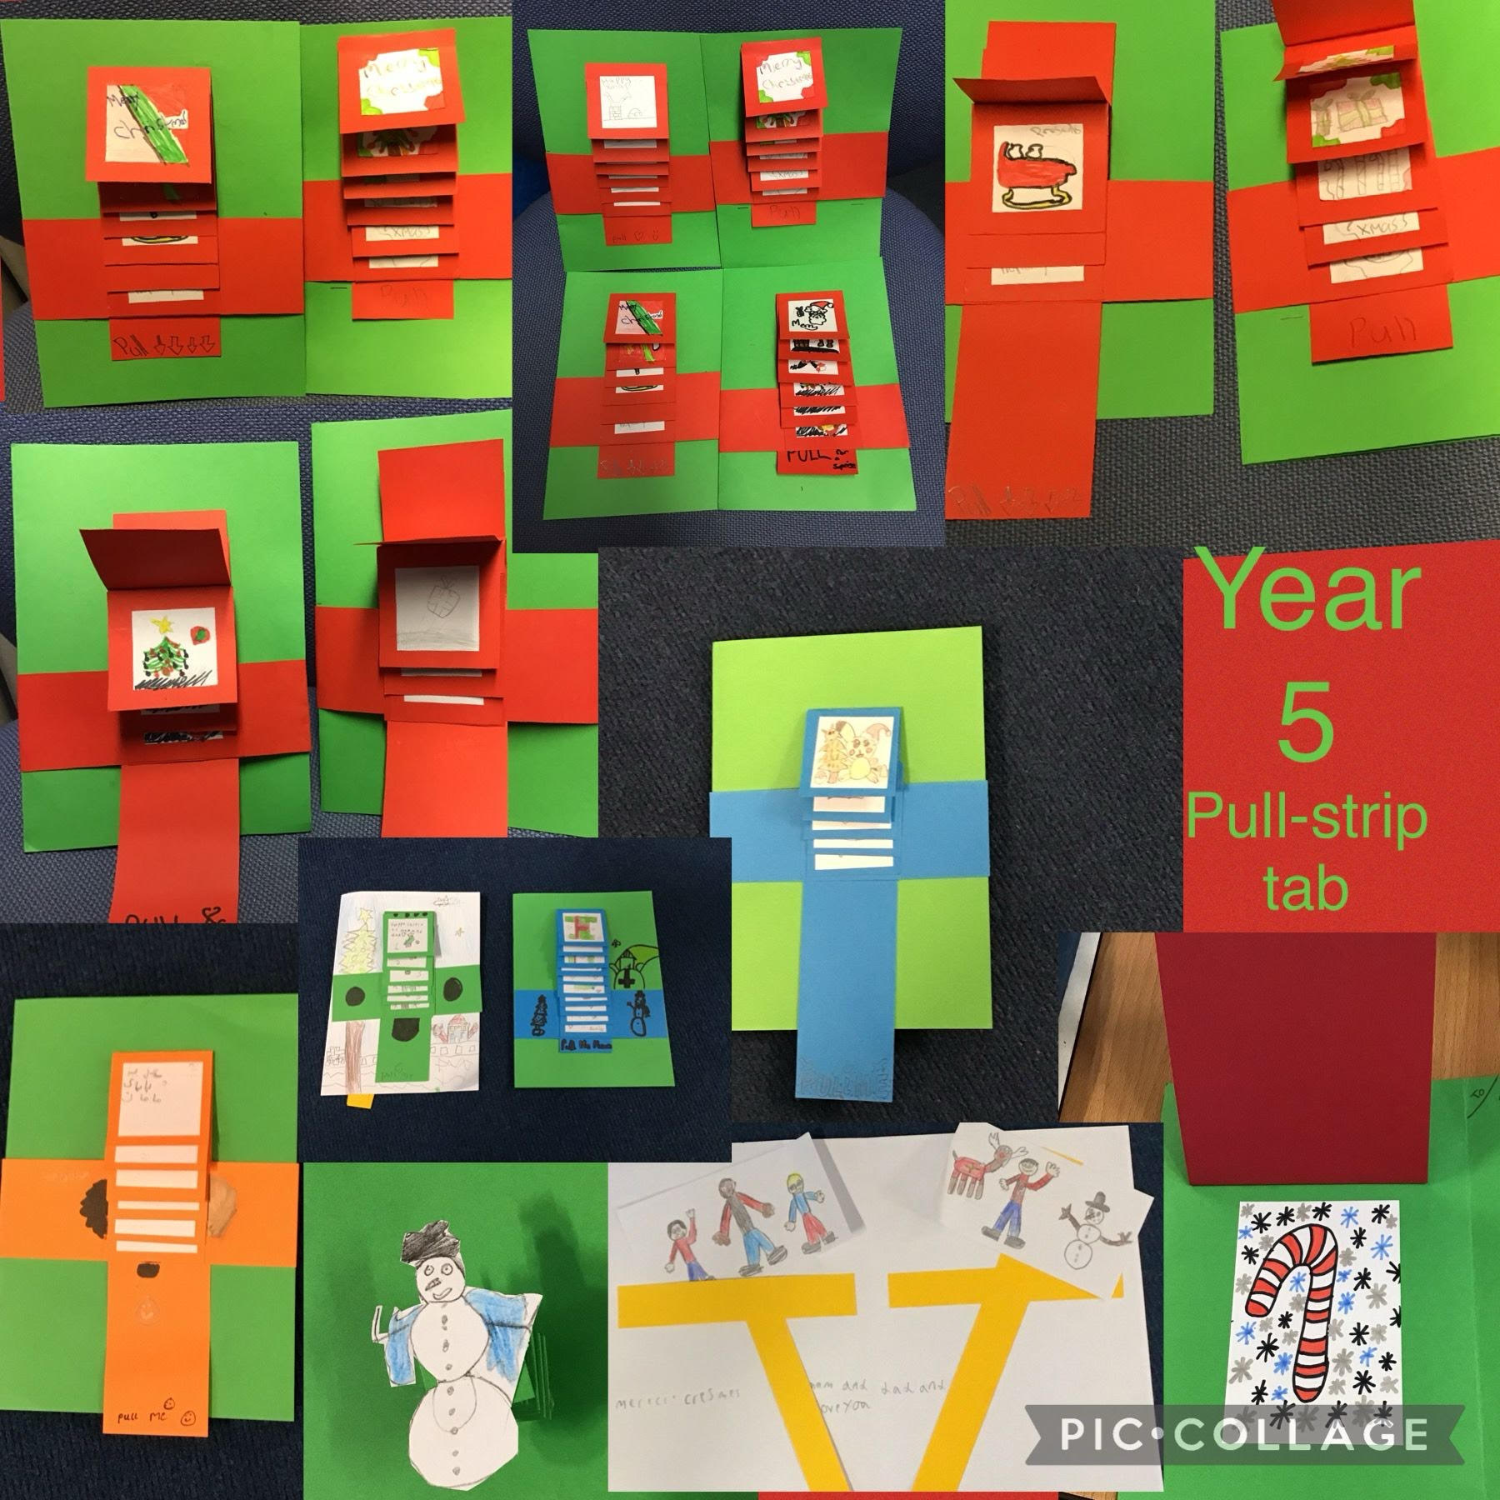

Slide 8
