Slide 1
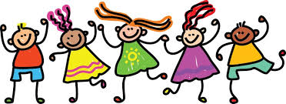
PSHE
At St Matthew’s Church of England Primary School

Slide 2
PSHE
PSHE stands for Personal, Social and Health Education.
PSHE at St Matthew’s already covers a wide range of areas that we believe are essential to children’s wellbeing, confidence and resilience both now and in later life.
PSHE education helps children and young people to achieve their potential by supporting their wellbeing and tackling issues that can affect their ability to learn, such as anxiety and unhealthy relationships. At St Matthew’s we are already teaching this important subject weekly to every class from Reception through to Year 6.

Slide 3

So What are we already Teaching?

Slide 4
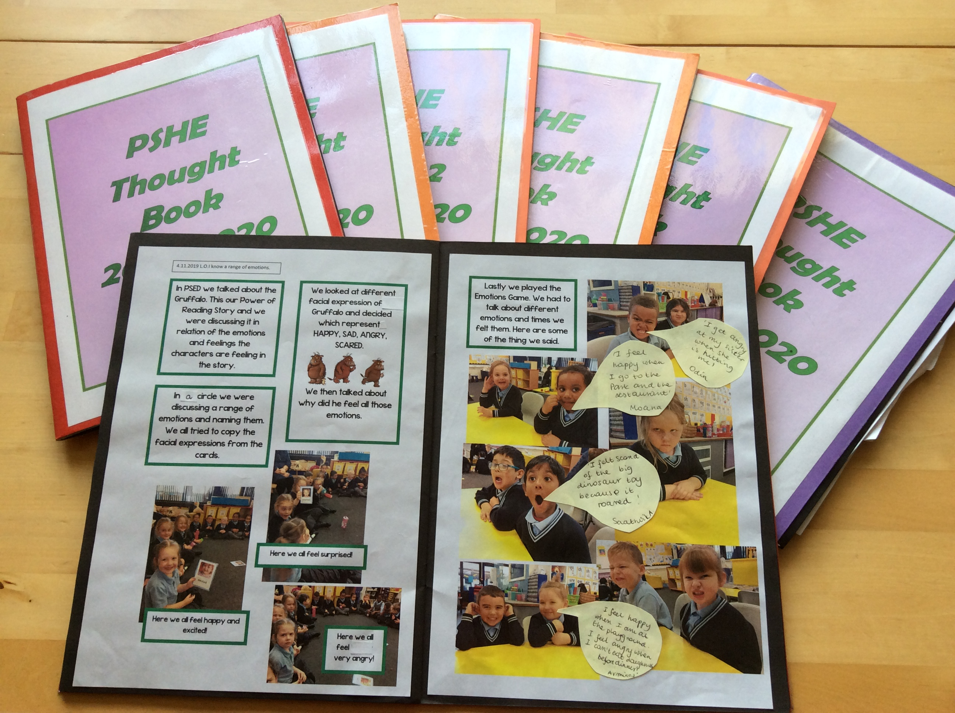
Already this year across the school we have covered:
Emotions
Healthy Living
Healthy friendships
Aspirations – when I grow up
Gifts and talents
Respecting others and different ways of life
Differences between male and female body parts
Staying safe – drugs, alcohol, gangs
Online safety
Peer pressure
Money matters

Slide 5

So What’s new?

Slide 6

With effect from September 2020 the Government has introduced:
Statutory Guidance for Relationships and Sex Education and Health Education
(published by the Department for Education)

Slide 7
At St Matthew’s we are already covering most of the new requirements within our PSHE lessons.
The statutory guidelines set out in the government document are to ensure that all schools are providing a quality education in 3 key areas:
Relationships
Sex Education
Health education

Slide 8
Healthy Lifestyles:
Mental health and wellbeing
Online wellbeing
Internet safety and harm
Physical health and fitness
Healthy eating
Drugs, alcohol and tobacco
Good quality sleep
Personal hygiene
Basic First Aid

Slide 9
Relationships:
Families and people who care for us
The importance of family
Respecting differences between families in school and the wider world
Different types of stable, caring relationships are at the heart of happy families
Caring friendships
Positive friendships
Managing conflict - repairing friendships
Trust
Respectful Relationships
Importance of respecting differences in others
Self respect
Courtesy and manners
Respect to others including those in positions of authority

Slide 10
Relationships:
Online relationships
Principles of keeping safe online
Sharing of online information and data
Being Safe
Boundaries
Concept of privacy
Appropriate and inappropriate contact
Seeking advice and help

Slide 11
Sex Education:
The National Curriculum for Science includes teaching on the main external body parts, the human body as it grows from birth to old age (including puberty and reproduction in some plants and animals). This element of education is compulsory and parents do not have the option to withdraw their child. A copy of the Science National Curriculum is available if you wish to see in more detail what is covered.
Sex education has not been made compulsory in primary schools, though the Department for Education ‘continues to recommend that all primary schools should have a sex education programme tailored to the age and the physical and emotional maturity of the pupils.
At St Matthew’s we have an embedded program of Sex Education and are looking to continue with this. We see Sex Education as a partnership between school and parents/carers.

Slide 12
Parental Rights:
The right of withdrawal from September 2020
The statutory guidance for Relationships Education and Health Education will come into effect in all primary schools from 2020.
Parents will not be able to withdraw their children from any aspect of Relationships Education or Health Education (which includes learning about the changing adolescent body and puberty).
Parents will be able to withdraw their children from any aspects of Sex Education other than those which are part of the science curriculum.
Headteachers in primary schools must grant requests to withdraw a pupil from sex education, other than where it is part of the science curriculum. The Head teacher, will however, first discuss with parents the benefits of receiving this important education, any detrimental effects that withdrawal might have on the child and the need to provide this education at home.

Slide 13

So how are we going to do this?

Slide 14
As a school we want to ensure that, not only do we comply with the statutory guidance, we also want to provide a wider PSHE curriculum that is relevant and up to date.

Slide 15
School – Parent/carer Partnership
The school is well aware that the primary role in children’s sex education lies with parents and carers. We wish to build a positive and supporting relationship with the parents of children at our school through mutual understanding, trust and cooperation.
We believe that children will benefit from being given consistent messages about their changing body and their increasing responsibilities.

Slide 16
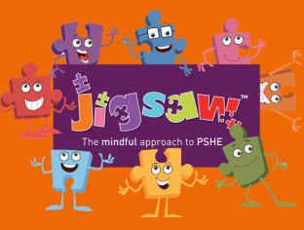
Jigsaw
We are planning to adopt a new scheme of work for PSHE that not only ensures we meet the Government’s Statutory Guidelines, but perhaps more importantly provides an excellent all round education in this important area of equipping children with the resilience and aspirations for their future.

Slide 17
Jigsaw
Jigsaw was launched in 2013 and is used by many schools in the UK. We have spoken to several teachers who have used the scheme before and they all recommend it.

Slide 18
We have taken details of the scheme to our Governors and they are in agreement that the scheme will provide an excellent foundation for our Personal, Social and Health and Education at St Matthew’s.
Hundreds of Church schools are using Jigsaw as their preferred PSHE programme. Jigsaw has created a whole document that links their programme of study to the Church of England’s vision and details how Jigsaw PSHE lessons meet these requirements.
The Jigsaw PSHE programme fulfils many of OFSTED’s requirements under their new framework.

Slide 19
Jigsaw consists of six half-term units of work (Puzzles), each containing six lessons (Pieces) covering each academic year.
Puzzles can launched with a whole-school assembly, with each year group studying the same unit at the same time (at their own level), building sequentially through the school year, facilitating whole-school learning themes.
These are the six areas…
Six Half Term Units of work
Each Year Group will cover the same area at the same time

Slide 20

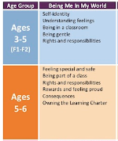
1. Being Me in My World
Includes understanding my place in the class, school and global community as well as devising Learning Charters.
For example…
In Reception:
Self Identity
Understanding Feelings
Being in a Classroom
Being gentle
Rights and responsibilities

Slide 21


2. Celebrating Difference
Includes anti-bullying (cyber and homophobic bullying included) and diversity work.
For example…
In Year 1
Similarities and differences
Understanding bullying and how to deal with it
Making new friends
Celebrating the differences in everyone

Slide 22
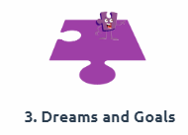

3. Dreams and Goals
Includes goal-setting, aspirations for yourself and the world and working together.
For example…
In Year 2:
Achieving realistic goals
Perseverence
Learning strengths
Group co-operation
Contributing to and sharing success

Slide 23
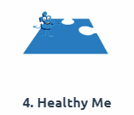

4. Healthy Me
Includes drugs and alcohol education, self-esteem and confidence as well as healthy lifestyle choices.
For example…
In Year 3:
Exercise
Fitness challenges
Food labelling & healthy swaps
Attitudes towards drugs
Keeping safe and why it’s important – online and offline
Respect for myself and others
Healthy and safe choices

Slide 24
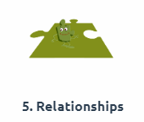

5. Relationships
Includes understanding friendship, family and other relationships, conflict resolution and communication skills.
EYFS: My Family, Make Friends, Falling Out, Being the Best friend we can be
Year 1: Families, Making Friends, Greetings, People Who Help Us, Being my Own Best Friend, Celebrating My Special Relationships
Year 2: Families, Keeping Safe, Friends and Conflict, Secrets, Trust and Appreciation, Celebrating My Special Relationships

Slide 25
5. Relationships
Year 3: Families, Friendship, Keeping Myself Safe, Being a Global Citizen, My Web of Relationships
Year 4: Jealousy, Love and loss, Memories of loved ones, Getting on and falling out, Girlfriends and boyfriends, Showing appreciation to people and animals
Year 5: Recognising Me, Getting On and Falling Out, Girlfriends and Boyfriends, Relationships and Technology,
Year 6: My Relationship Web, Love and Loss, Power and Control, Being safe with Technology

Slide 26
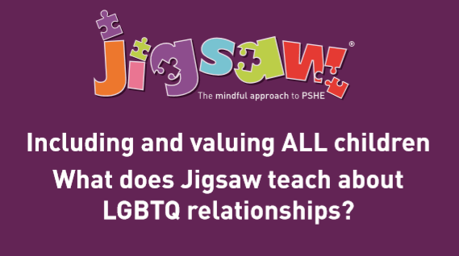
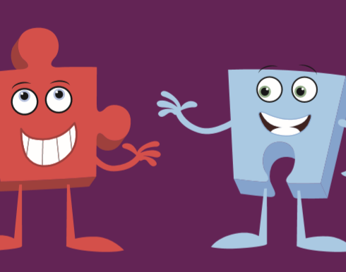
Relationships

Slide 27
Relationships
Jigsaw does not ‘promote’ or ‘directly teach’ LGBTQ lifestyles. Children learn about a whole range of differences, such as physical appearance and personality, likes and dislikes, and that people can have differences of opinion. Within the context of these lessons they will also be introduced to different cultures and ethnicities, people with different religions and beliefs.
In Year 2, for example there are lessons on What makes a family and within this context the idea of a family with 2 mums or 2 dads may be discussed.
In KS2 there are lessons about bullying which reference use of the word ‘gay’ as an insult – the teacher’s role will be to explain the term as romantic feelings between 2 people of the same sex but not in the context of any sexual activity.

Slide 28
Relationships
The Equality Act requires schools to eliminate discrimination; advance equality of opportunity; and foster good relationships. By doing so, the Equality Act encourages schools to meet the diverse needs of children and to improve outcomes for all pupils regardless of background. Part of the Equality ‘duty’ is to teach children about rights and responsibilities, acceptance, empathy and understanding of others.

Slide 29
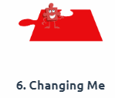
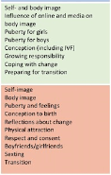
6. Changing Me
This puzzle includes sex and relationships education in the context of coping positively with change. (includes age-appropriate sex education). This is a brief summary of what each year group will cover under the Jigsaw scheme of work:
Reception: Bodies, Respecting my body, Growing up, Growth and change, Fun and fears, Celebrations.
Year 1: Life Cycles, changes in me, changes since being a baby, Differences between male and female bodes (correct terminology), Linking growing and learning, Coping with change, Transition
Year 2: Life cycles in nature, Growing from young to old, Increasing independence, Differences in male and female bodies (correct terminology), Assertiveness, Preparing for transition.

Slide 30
6. Changing Me
This puzzle includes sex and relationships education in the context of coping positively with change. (includes age-appropriate sex education)
Year 3: How babies grow, Understanding a baby’s needs, outside body changes, inside body changes, family stereotypes, Challenging my ideas, preparing for transition
Year 4: Being unique, Having a baby, Girls and puberty, confidence in change, Accepting change, preparing for transition, Environmental change.
Year 5: Self and body image, Influence of online and media on body image, Puberty for girls, Puberty for boys, Conception (including IVF), Growing responsibility, Preparing for transition.
Year 6: Self image, body image, Puberty and feelings, Conception to birth, Physical attraction, Respect and Consent, Boyfriends/girlfriends, Sexting, Transition.

Slide 31

W
Please have a look at the scrapbooks.
Please have a look at the sample resources available from Jigsaw
Please feel free to ask questions
We welcome your comments
We want PSHE at St Matthew’s to reflect our Christian ethos and to be a strong parent/school partnership.
Thank you!
PSHE at St Matthew’s
“Whatever you do, do it with all your heart”

